Slide 1
Web3
Informative Presentation

Slide 2
Web3(Informative Presentation )
Submitted to:
Bineeta Rahman
English department /Bracu
Created by
Name:Kainat quaderee &Khaled Karim
Student id:
Kainat:22201090
Khaled Karim: 22201091
Department:CSE

Slide 3
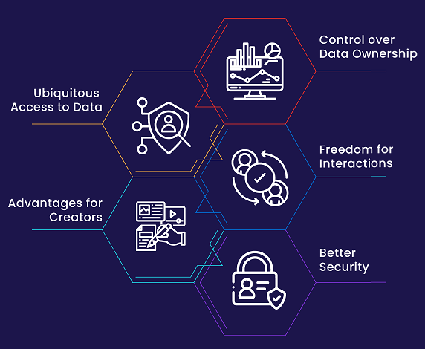
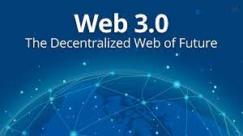
Web 3.0 Third Generation of the evolution of web technologies
Web3 is the largest internet technology that leverages machine learning, artificial intelligence and block-chain to achieve real world communication.
Data Ownership
Transparency
Semantic Web
Fewer Intermediaries
Uninterrupted Services

Slide 4
Introduction to Web3
Web3 is an idea for a new iteration of the World Wide Web which incorporates concepts such as decentralization, block-chain technologies, and token-based economics
The term "Web3" was coined in 2014 by Ethereum co-founder Gavin Wood, and the idea gained interest in 2021 from cryptocurrency enthusiasts, large technology companies, and venture capital firms.
Instead of a Web monopolized by large technology companies, Web3 embraces decentralization and is being built, operated, and owned by its users. Web3 puts power in the hands of individuals rather than corporations.
While Web 2.0 focuses on interactive websites and user-created content hosted on centralized websites, Web3 will give more control to users over their online data.

Slide 5
Web 3.0 Third Generation of the evolution of web technologies
Despite the numerous benefits of Web3 in its current form, there are still many limitations that the ecosystem must address for it to flourish.
Various technologies such as block-chain, AI, and machine learning power Web3. It will make use of semantic data, 3D graphics, and more. Likely, less advanced devices will not be able to handle Web3. Users will need a device that has above-average specifications to use Web3.
Difficult to regulate: Some experts also believe that decentralization will lead to difficulties in monitoring and regulating Web3. As a result, we could see a rise in cybercrimes.
Existing websites will need an upgrade: As Web3-based websites and applications become popular, the pressure will come on existing businesses to upgrade. They will be under pressure to upgrade their digital offerings so that they don’t lose their captured market.
The technical barrier to entry to using Web3 is currently too high. Users must comprehend security concerns, understand complex technical documentation, and navigate unintuitive user interfaces. Wallet providers, in particular, are working to solve this, but more progress is needed before Web3 gets adopted en masse.

Slide 6
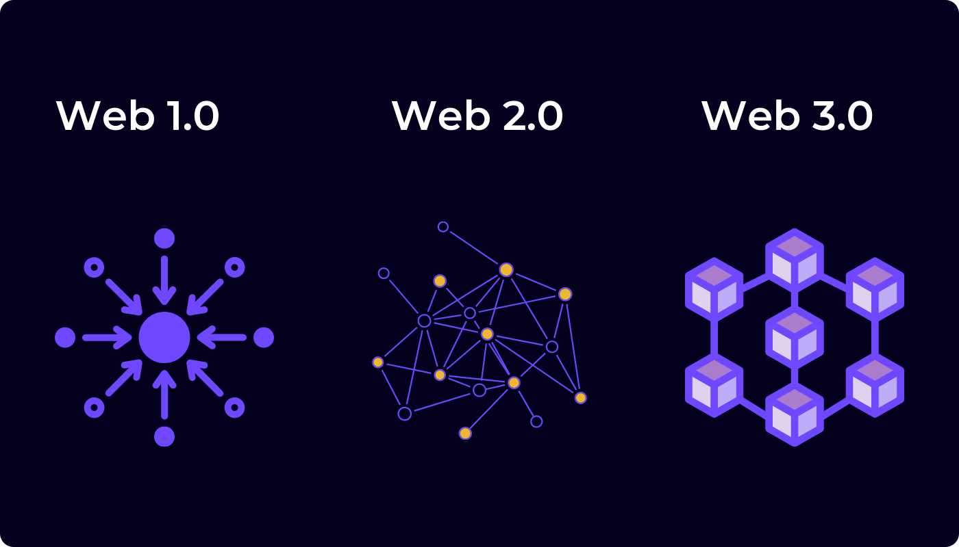
Web 3.0 Third Generation of the evolution of web technologies
Important Web3 features, like Sign-in with Ethereum, are already available for anyone to use at zero cost. But, the relative cost of transactions is still prohibitive to many. Web3 is less likely to be utilized in less-wealthy, developing nations due to high transaction fees. On Ethereum, these challenges are being solved through network upgrades and layer 2 scaling solutions. The technology is ready, but we need higher levels of adoption on layer 2 to make Web3 accessible to everyone.
Web3 isn’t difficult, but it is different. Educational initiatives informing Web2 users of these Web3 paradigms are vital for its success.

Slide 7

Conclusion
World already started moving towards web3 and its advantages are increasing by huge margins.
Web 3.0 focuses on resolving the setbacks evident of web 2.0.
It will be difficult for newbies to grasp inaccessible to less advanced gadgets.
The decentralization will lead to difficulty in monitoring and regulating Web3.
On the contrary, the progress in web3 development depends on a collection of private businesses, individuals and non-profit organizations.

